Slide 1
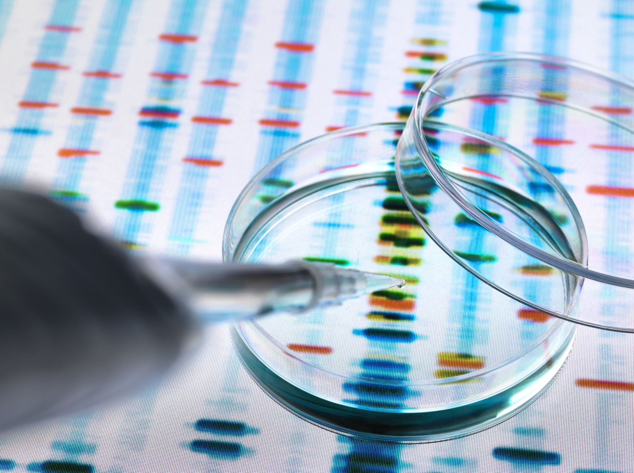
MEDICATION TREND AND BIOSIMILAR IMPACT ANALYSIS
Anish Sanan
Veer Patel

Slide 2
Findings
The total change in medication cost PMPM between 2018 and 2021 : $30.65234
The top 10 medications with the highest PMPM increases between 2018 and 2021 :
Brnd_Name | Gnrc_Name | PMPM_Increase
Keytruda | Pembrolizumab | 6.185769416
Darzalex Faspro | Daratumumab-Hyaluronidase-Fihj | 2.822786386
Eylea | Aflibercept | 2.809892165
Rituxan | Rituximab | 2.064592276
Prolia* | Denosumab* | 1.278101599
Imfinzi | Durvalumab | 1.223136485
Tecentriq | Atezolizumab | 1.170484866
Mvasi | Bevacizumab-Awwb | 0.90706621
Tepezza | Teprotumumab-Trbw | 0.816314851
Entyvio | Vedolizumab | 0.815524539

Slide 3
Findings
Total Spending Increase - $283,521,065.60
Breakdown of Spending Increase:
Increase Due to More Patients - $187,686,210.10
Increase Due to Per-Patient Cost - $95,834,855.52
33.81% Increase due to the per-patient cost and 66.19% increase due to more patients
Total Gross Impact of Biosimilars in 2021 - $307,921,066

Slide 4
Thank You

